Slide 1
Word and Sentence Tokenization with Hidden Markov Models
Bryan Jurish Kay-Michael Würzner
presented by Vilém Zouhar, 2020

Slide 2
Motivation
Isn’t tokenization already solved?
Simple tokenization schemes fail
One always starts with a simple:
text.split(‘ ‘)
What about ‘The lazy fox‘?
text.split(r‘\ +‘)
What about ‘The lazy
fox’?
text.split(r’\s+’)

Slide 3
Motivation - continuation
text.split(r’\s+’)
What about ‘jumped over the fence.’?
Do we want to keep the full stop?
text.split(r’(\w+)’)
What about ‘jumped over the fence..’?
Do we want to cluster all non-word characters?
What about ‘The 1st fox’?
Do we want 1 and st to be separate tokens?
Simple regex won’t do
What is a token?
Can we instead learn tokenization from examples?

Slide 4
What is a token?
Vignátová-Mimochodská, Merriam-Webster's, Tumu-M'Pongo
10-year, one-liners, self-proclaimed, je-li
United Kingdom-United States relations
5-3, 5-3+1, U+2010, 2:4, 14:34, 10:00-14:00
10000, 10 000, 10,000
3.14159, 10.12., 10. prosince, U.S.A., H2O
km/h, A/C, s/he, byl(a), °C
N40° 44.9064', W073° 59.0735'
www.noviny.cz/clanek-o-necem franta.novak@chytra-firma.com
cos, tys, polívkus; proň, ses, abys; křížem krážem
Arbitrary decision, but data must be consistent
examples by Geneea, 2018 Czechitas talk

Slide 5
Task - definition
Input: an arbitrary string
Output: a list of list of strings (sentences of words)
Training data: untokenized (raw) text + tokenized text in sentences
Training data example (NLTK’s webtext):
[['Customising', 'toolbar', 'breaks', 'the', 'throbber', '!'], …]
<tab>Customising toolbar breaks the throbber!<newline>...

Slide 6
Task - evaluation
For simplification only word-level
Consider the output to be expanded per char:
<tab>Customising toolbar breaks the throbber!<newline>
N NNNNNNNNNNWNNNNNNNWNNNNNNWNNNWNNNNNNNNWSN
N - no boundary, W - word boundary
From this and the gold data we can compute TP, FP, TN, FN (w.r.t. W or S)
TN will be considerably more common, so accuracy (TP+TN)/total is useless
Compute the precision and recall and possibly F1

Slide 7
The WASTE Tokenizer
HMM multi-step tokenization system

Slide 8
WASTE - concepts
Do a classification for each character?
No, instead create suggestions by some regex and classify that:
(e.g. \w+ from the previous discussion)
raw: The 1st place goes to Uos-y Otidias.
prolix: The 1 st place goes to Uos - y Otidias .
How to feed the prolix strings into an HMM?
Extract features, which have a finite set of values
Note: Prolix aggressivity creates an upper bound on recall, FN > threshold

Slide 9
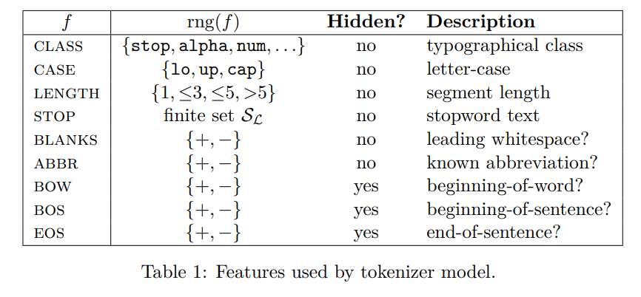
WASTE - features

Slide 10
WASTE - HMM setup
Observable variables: features (class, case, length, …)
Hidden variables: predictions (end of word, end of sentence, beginning of s.)
For now assume only two: EOW, EOS
Hidden variables expand to a cartesian product (EOW, EOS)
(T, T), (T, F), (F, T), (F, F)
But we can omit (F, T), as it doesn’t make sense
Observable variables expansion will be covered in the implementation details
Finally we take a look at the most probable path using Viterbi

Slide 11
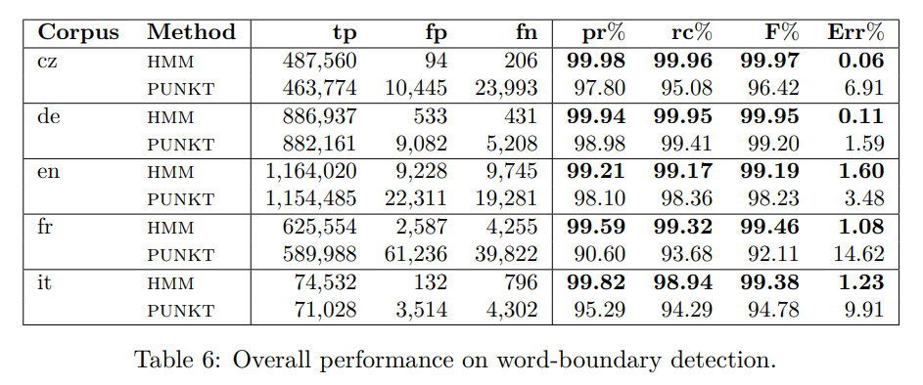
WASTE - results - word-level
Compared to Punkt (NLTK)
Roughly what to expect of a tokenizer

Slide 12
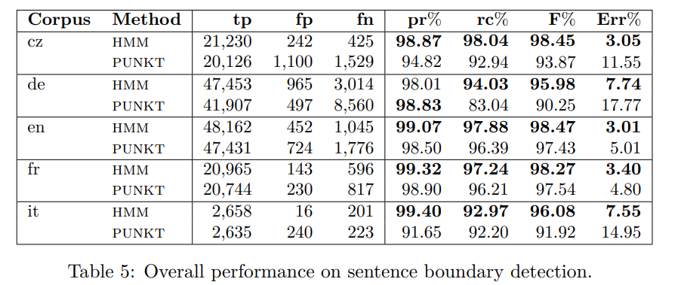
WASTE - results - sentence-level
Compared to Punkt (NLTK)
Roughly what to expect of a tokenizer

Slide 13
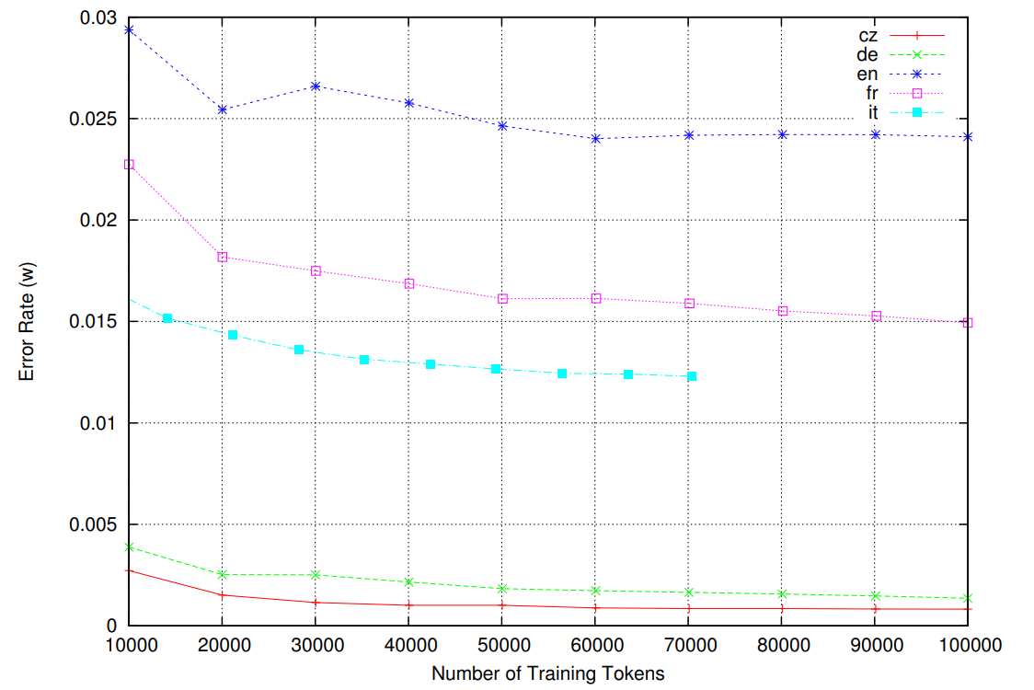
WASTE - data size - word-level
More data doesn’t help on word-level
Better on CS/DE
Probably not because of the language itself
Rather because of more straightforward definitions of a token

Slide 14
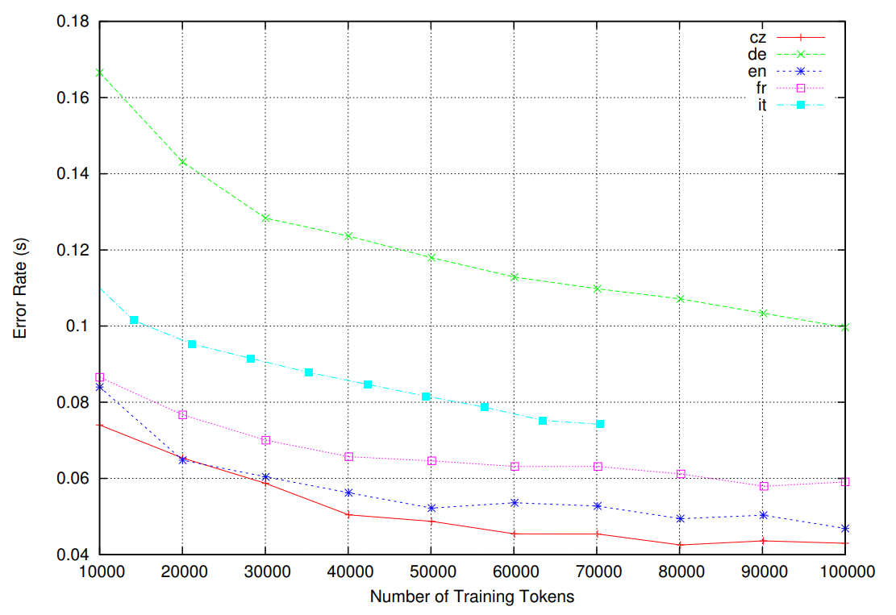
WASTE - data size - sentence-level
More data helped, why?
Perhaps the task of sentence segmentation requires more insight (e.g. what words usually begin a sentence)
More training examples thus help

Slide 15
zouharvi/hmm-tokenizer
implementation of a (very basic) HMM tokenizer
https://github.com/zouharvi/hmm-tokenizer

Slide 16
Implementation
What emission model to use in each state?
Not described in the paper, but multivariate Gaussian seems the best fit for this
(best is multivariate dirichlet distribution, but not supported by hmmlearn)
Assume independence, even though it is certainly not the case here
Every model in a state can have N means and variances

Slide 17
Implementation - encoding
Every model in a state can have N means and variances
In case of LENGTH {1, <4, <6, >=6} let’s encode it as {0, 1, 2, 3},
compute the mean 1.9 and variance 1.1 (more on the computation later)
This is very wrong
Alternative:
Split LENGTH into 4 independent indicator variables, i.e. with values {0, 1}
compute the means (0.1, 0.3, 0.4, 0.2) and variances (0.3, 0.2, 0.5, 0.2)
Use this indicator encoding for all original variables and string the output into one single vector

Slide 18
Implementation - parameter estimation
Assume we pre-processed the training data:
- big string of gold data A = ...NNNNNNWNNNNNNSNNWNNW...
- sets of encoded vectors for (T, T), (T, F), (F, F)
State prior probabilities P(X) = A.count(X)/A.length
Transition probabilities T(X|Y) = A.count(XY)/A.count(Y)
Means and variances
= piece-wise from encoded vectors from pre-processed sets

Slide 19
Implementation - results
Train on NLTK’s webtext
Evaluate on Inaugural Address Speech
A big issue: lack of good bad data
Train data evaluation:
TP: 6.37%, FP: 0.00%
FN: 11.79%, TN: 81.84%
Precision: 100.00%
Recall: 35.06%
Heldout data evaluation:
TP: 9.21%, FP: 0.00%
FN: 9.30%, TN: 81.49%
Precision: 100.00%
Recall: 49.74%

Slide 20
Implementation - usage
To replicate the results:
git clone git@github.com:zouharvi/hmm-tokenizer.git
hmm-tokenizer/src/main.py -d
To tokenize a string:
hmm-tokenizer/src/main.py -v “Wie geht’s, Alice?”
To enter interactively:
hmm-tokenizer/src/main.py -i

